Slide 1
Accelerate the customer journey
How digital is disrupting the fuel retail experience
DIGITAL FUEL RETAIL SURVEY 2018

Slide 2
DISRUPTION IS THE NEW NORMAL
CHALLENGES FUEL RETAILERS MAY BE FACING IN THE FUTURE…
CUSTOMERS WILL NO LONGER NEED TO BUY FUEL
CUSTOMERS WILL NO LONGER OWN AND MAINTAIN A CAR
CONNECTED CARs WILL ENABLE NEW SERVICES
COMPETITION FOR CONSUMER MARKET WILL GROW
Copyright © 2018 Accenture. All rights reserved.

Slide 3
FUEL RETAILERS recognize the power of digital
No company is immune from digital disruption. But for fuel retailers, digital technologies that automate, accelerate and enhance the customer experience are a powerful ally.
According to a recent survey of fuel retail professionals, there are five key trends influencing fuel retailers’ decision making around digital transformation. Read on to find out how fuel retailers’ investments in digital have the potential to improve the customer experience and revolutionize their business models.

Slide 4
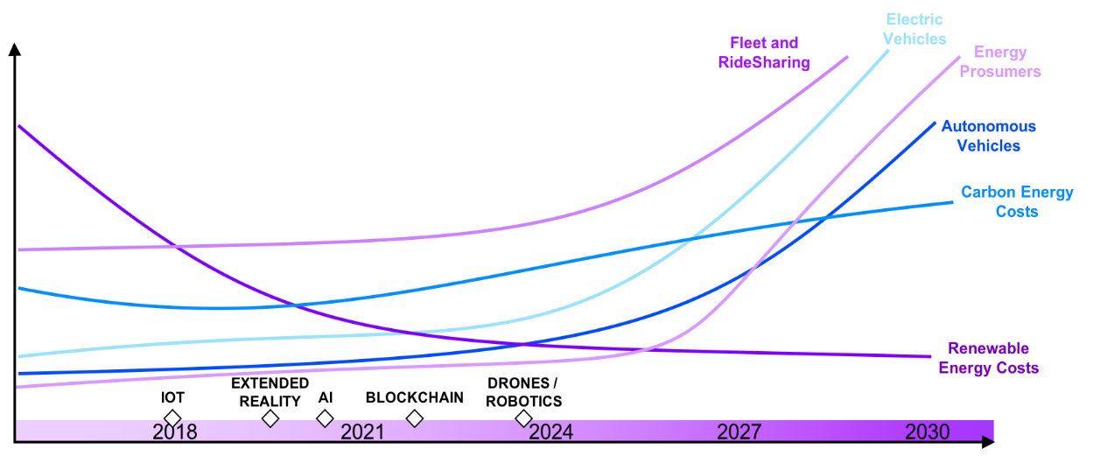
FIVE TRENDS ARE disrupting THE FUEls RETAIL LANDSCAPE faster than expected
1
DISRUPTION IS ACCELERATING: challenges around capturing margin and rising competition are being complicated by the arrival of electric vehicles (EVs) and changing consumer behaviors
4
DIGITAL MATURITY IS THE GOAL: investments in skills training, automation and partnerships are essential to realize digital aspirations
2
COMMITMENT TO DIGITAL INVESTMENTS:
digital investments are expected to increase significantly to better engage with customers and improve services
5
BETTER FOUNDATIONS NEEDED TO REALIZE DIGITAL VALUE: embracing partner ecosystems will better address gaps in retailers’ performance and drive business model maturity
3
ANALYTICS ENHANCES PERFORMANCE: digital brings numerous advantages —analytics, in particular, drives performance improvements

Slide 5
Trend 1
Disruption IS HERE and accelerating
Copyright © 2018 Accenture. All rights reserved.

Slide 6
Fuel retailers see DEMAND disruption COMING from electric vehicles and changing consumer behaviors
Trend 1
Which of these trends do you believe will have the greatest impact on your fuel retail business in the next 3-5 years?*
Rise in electric vehicles usage
57%
Changing consumer behavior/demands
41%
Increasing vehicle/engine efficiency
32%
Regulatory changes
31%
Increasing competition
*trends vary by market
26%
Multiple responses (top five only)
Base = Total sample; n=88
Copyright © 2018 Accenture. All rights reserved.

Slide 7
Trend 2
Commitment to digital investments
Copyright © 2018 Accenture. All rights reserved.

Slide 8
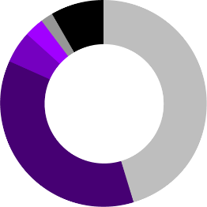
Digital investment will increase significantly in the coming years…
Trend 2
In the next 3-5 years, does your business plan to invest in digital technologies?
2%
Key
8%
3%
45%
Significantly more (20% or greater)
5%
More (1% - 19% more)
The same
Less (1% - 19% less)
Significantly less (20% or greater)
Not investing in digital technology
Don’t know
36%
Unique responses Base = Total sample; n=88
Copyright © 2018 Accenture. All rights reserved.

Slide 9
…to better engage with customers…
Trend 2
…and to improve services
If you are planning to invest more in digitalization in the next 3-5 years, which of the following outcomes are you looking to achieve?
Which of the following capabilities and services are you investing in at individual forecourts/filling stations in the next 3-5 years?
72%
69%
60%
58%
51%
45%
Better customer retention
Increase in convenience store sales
Increase in number of customers
Mobile payments
Mobile marketing/loyalty platforms
Contactless payments
Multiple responses (top three only) Base = Total sample; n=88
Copyright © 2018 Accenture. All rights reserved.

Slide 10
66%
FUEL Retailers recognize digital can help, in fact…
Do you believe that any of the following could improve the customer experience in your fuel retail site?
More automation of the fuel retail site
66%
More personalized offers to customers
53%
Enhanced loyalty schemes
45%
Better facilities in the fuel retail site
BELIEVE AUTOMATION CAN IMPROVE THE CUSTOMER EXPERIENCE …
44%
More hyper-personalized offers to customers
42%
Multiple responses (top five only)
Base = Total sample; n=88
Copyright © 2018 Accenture. All rights reserved.

Slide 11
Trend 3
Analytics enhances performance
Copyright © 2018 Accenture. All rights reserved.

Slide 12
Trend 3
What kind of advantage (if any) do you believe higher digitalization will have on your fuel retail business?
1%
Fuel RETAILERS BELIEVE DIGITAL can positively impact their business -
In particular data analytics
24%
28%
Key
Great
Small
Large
None
Average
47%
Unique responses
Which of the following technologies are driving the greatest impact in terms of the performance of your fuel retail business?
Analytics/big data
66%
Automation
53%
Mobility
36%
Multiple responses (top three only)
Base = Total sample; n=88
Copyright © 2018 Accenture. All rights reserved.

Slide 13
Trend 4
Digital maturity is the goal
Copyright © 2018 Accenture. All rights reserved.

Slide 14
Fuel retailers’ aspirations for digital are high…
Trend 4
Aspirational
40%
Semi-mature
28%
Mature
14%
Localized
13%
How mature is the use of digital technologies within your fuel retail business?
Just getting started
10%
Novice
7%
Don’t know
7%
Multiple responses
Base = Total sample; n=88
Copyright © 2018 Accenture. All rights reserved.

Slide 15
automation, DIGITAL skills and partnership development are in focus
Trend 4
Do you expect any part of the current roles you have in your fuel retail sites to be more automated over the next 3-5 years?
14%
Don’t know
What is your main incentive for entering into strategic partnerships?
11%
No
49%
Access to technology/digital innovation
75%
Yes
44%
Access to new services
25%
Don’t know
Do you plan to invest in digital skill training and reskilling programs for your employees at fuel retail sites over the next 3-5 years?
10%
No
40%
Better fuel retail business margins
65%
Yes
Multiple
Responses
Base = Total sample; n=88
Unique responses
Base = Total sample; n=88

Slide 16
Trend 5
BETTER FOUNDATIONS ARE needed to realize digital value
Copyright © 2018 Accenture. All rights reserved.

Slide 17
…But they may not be adequately prepared
Trend 5
FUEL RETAILERS RECOGNIZE THE CHALLENGES AHEAD
…and most know they cannot “go it alone”
Which role in your company is primarily responsible for driving its digital strategy and agenda?
How would you plan to carry out these digital technology investments?
49%
31%
Key
No specific person responsible
Outsourced
Via a large IT service provider
Don’t know
C-suite (All C Suite excluding CDO)
CDO
27%
Non C-suite
In-house
Unique responses
Base = Total sample; n=88
Multiple responses
Base = Total sample; n=88
Copyright © 2018 Accenture. All rights reserved.

Slide 18
the road ahead
Fuel retailers may only be at the start of their digital journey—but they know where they are headed and are aware of how to future-proof their business...
STEPS FOR FUEL RETAILERS TO BUILD BUSINESS READINESS AND PREPARE FOR GREATER DIGITAL DISRUPTION
1
2
3
4
Use data to better understand your customers
Develop, create and leverage a partner ecosystem
Drive digital and innovation holistically across the business
Build or access skills and develop key leadership roles to scale digital and earn consumer trust
Copyright © 2018 Accenture. All rights reserved.

Slide 19
About the survey
The survey questioned 88 professionals (subscribers and readers of PetrolPlaza) working in the fuel retail sector including:
National oil companies, international oil companies and independents
Fuel retail franchise owners
Independent fuel retail owners
Grocery store retailers
Contractors and consultants to the fuel retail industry
Accenture’s Digital Fuel Retail Survey was undertaken by the survey agency McGuire on behalf of Accenture in collaboration with PetrolPlaza. It was conducted online during the spring and summer of 2018.
Copyright © 2018 Accenture. All rights reserved.

Slide 20
Who can help?
NEALE JOHNSON Managing Director Fuel Retail, Europe, Accenture
Follow us
Follow us on LinkedIn
BRIAN GRAY Managing Director Fuel Retail, North America, Accenture
@AccentureEnergy #digitalenergy
Explore our Energy Blog
Visit
Accenture 2018 Digital Fuel Retail Report
to download a copy
Copyright © 2018 Accenture. All rights reserved.

